Slide 1
iGroup - Iteration 1
Team 6

Slide 2
Contents
User Interface
New User stories
Architecture
Class Diagram
Algorithm
Coding Implement

Slide 3
User Interface
UI test (student)
Able to login
Able to take survey
Able to submit
UI test (Instructor)
Able to login
Able to set survey
Able to Create Link
Able to manually setting group
Able to get result

Slide 4
New User stories
As an instructor, I want to create the survey by clicking the “create” button, so that I can add questions into the survey.
As an instructor, I want to save the survey by clicking the “save” button, so that I can generate a link to the survey and send it to the student.
As an instructor, I want to login the system with my BU credential, so that I can access the system.
As a student, I want to login to the system with my BU credential when I click the survey URL, so that I can take the survey.
As a student, I want to submit the survey by clicking the “submit” button, so that my answers can be recorded and saved in DB.
As a student, I want to rate the page (UI) after the survey, so that developers know how bad their work may be and ways to improve.
As an instructor, I want to be able to check the status of survey by clicking
As an instructor, I want to be able to check the group assigning result, so that I can let myself and students know.

Slide 5
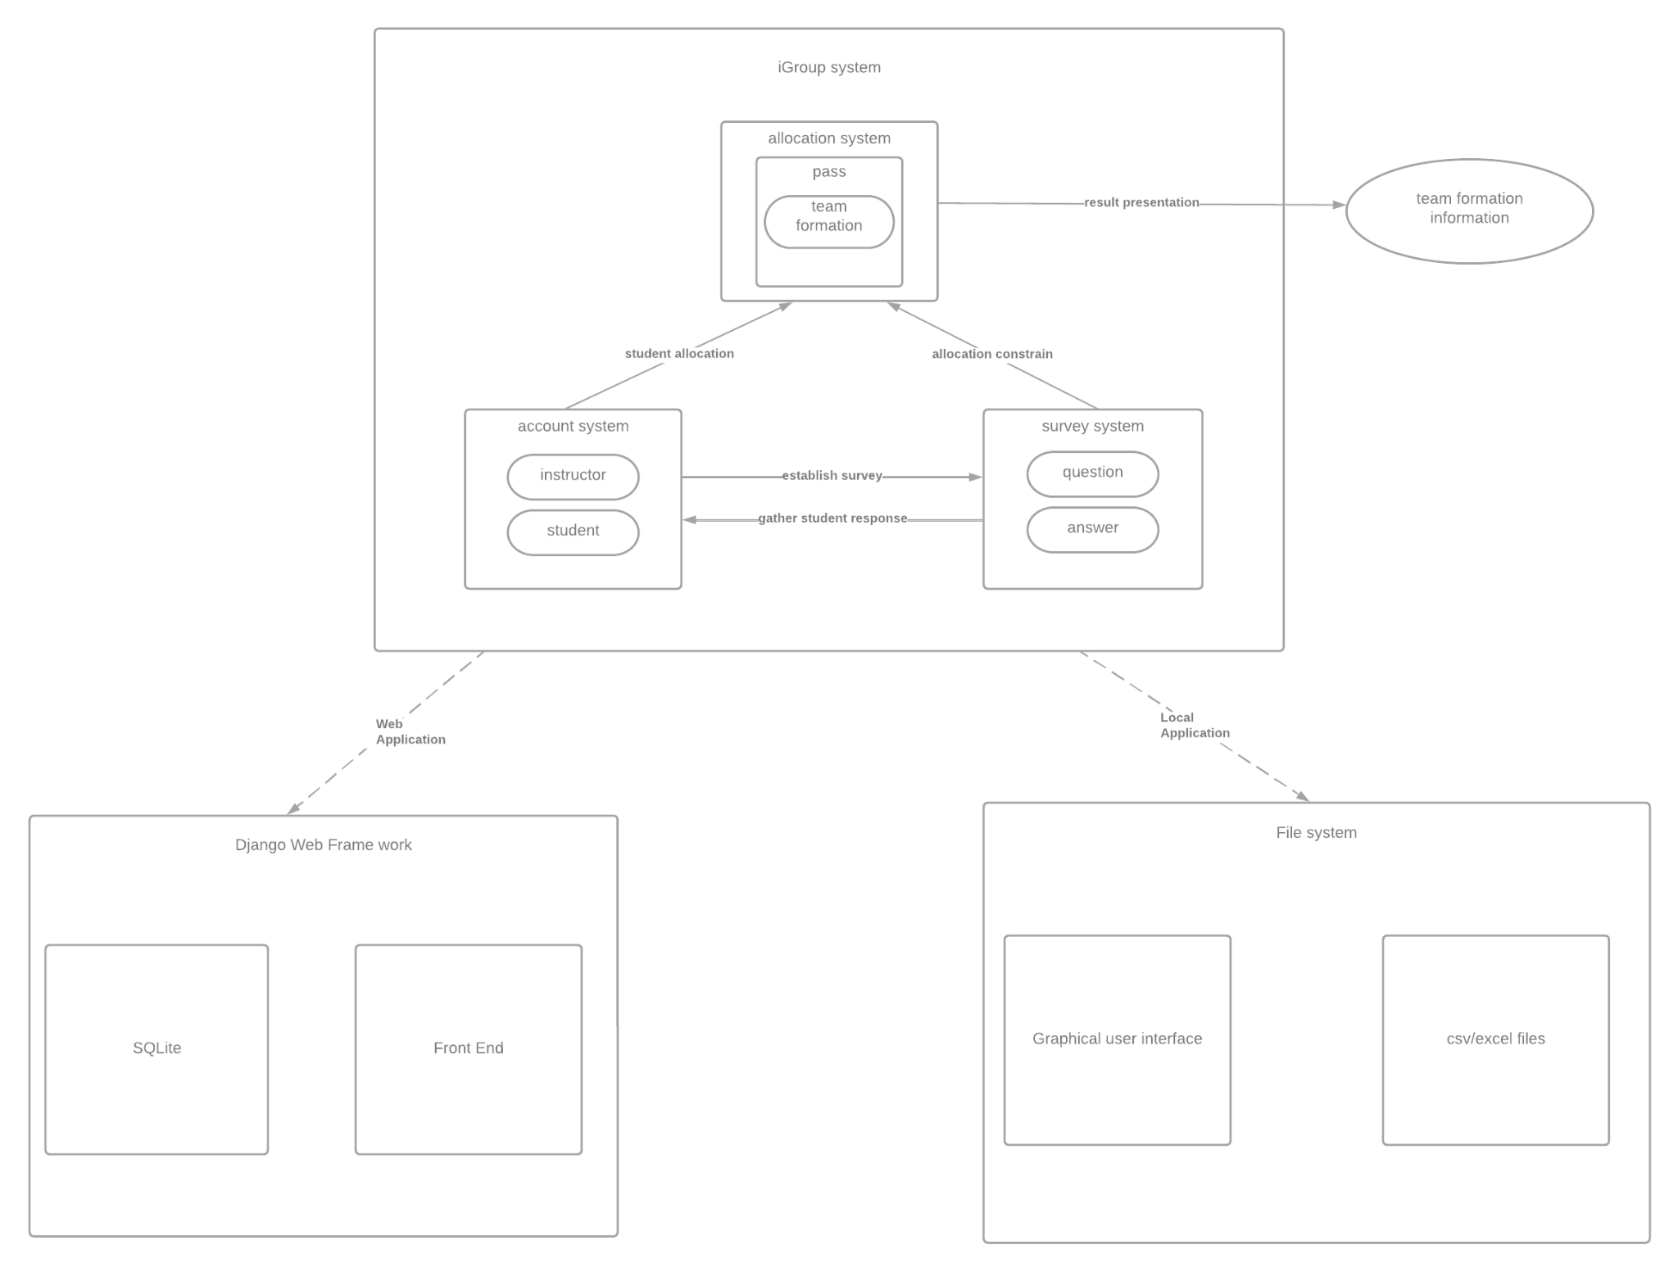
Architecture
Iteration 1
next iteration

Slide 6
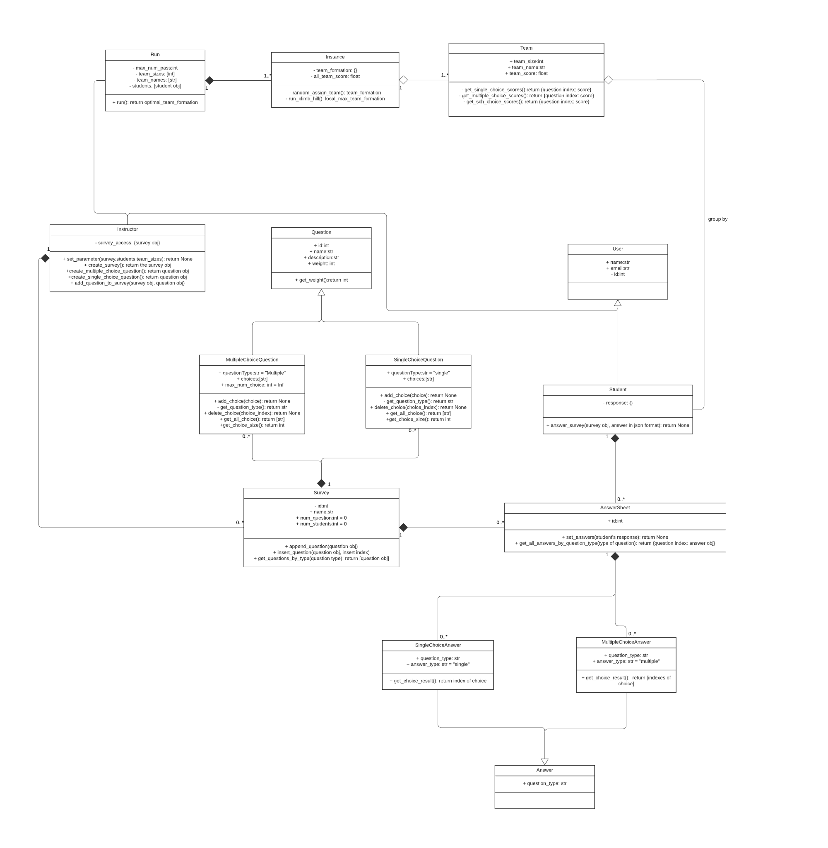
Class Diagram

Slide 7
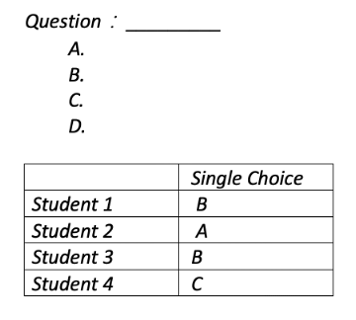
Algorithm – Single_Choice Question

Slide 8
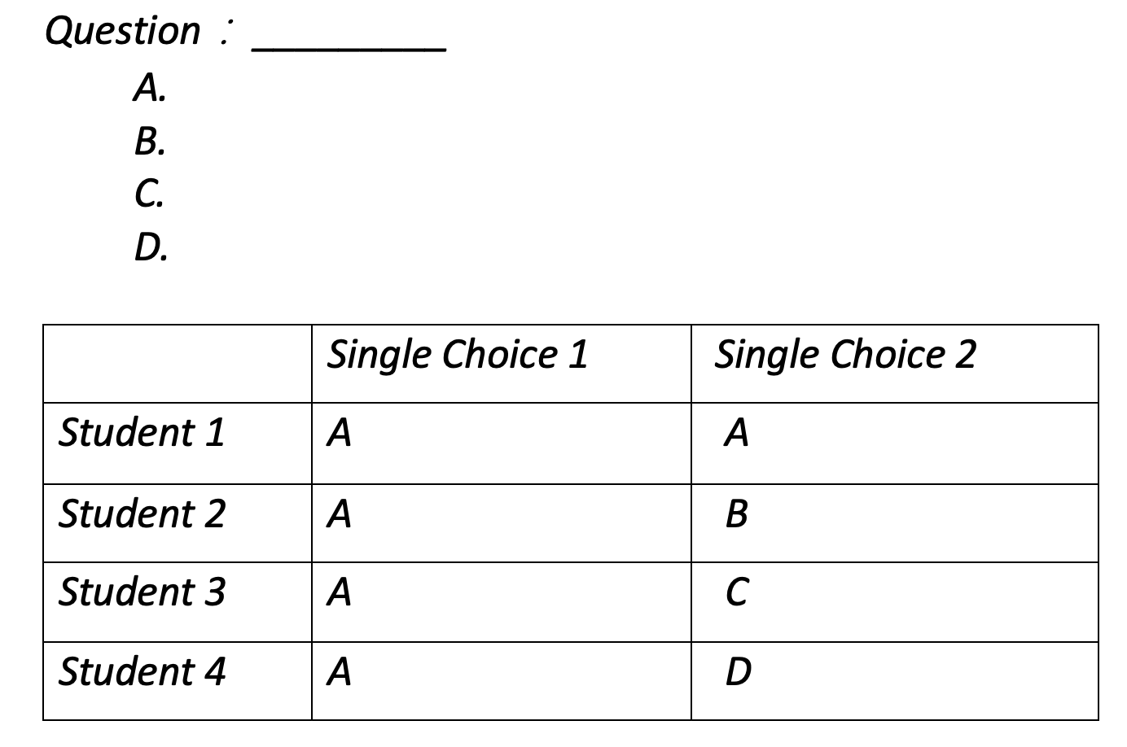
Algorithm – Single_Choice Question
Perfect match
Dissimilarity

Slide 9
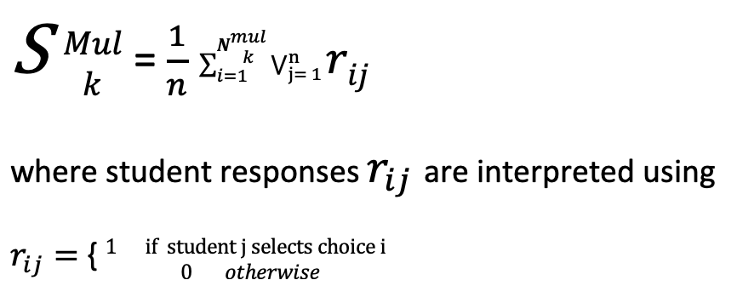
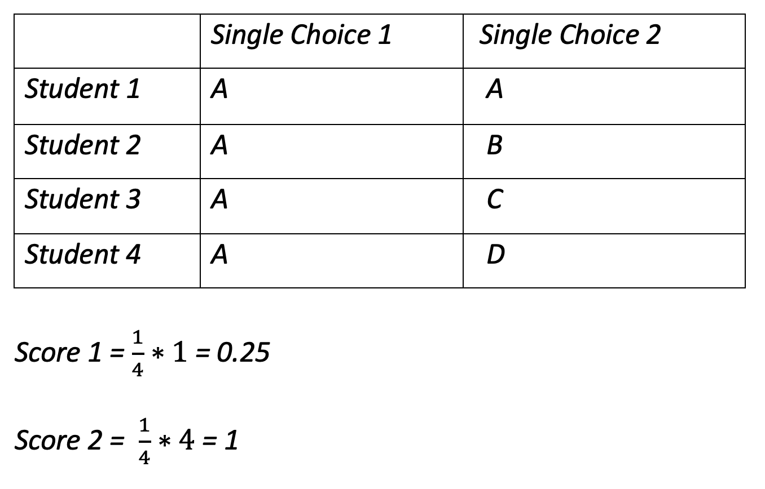
Algorithm – Single_Choice Question

Slide 10
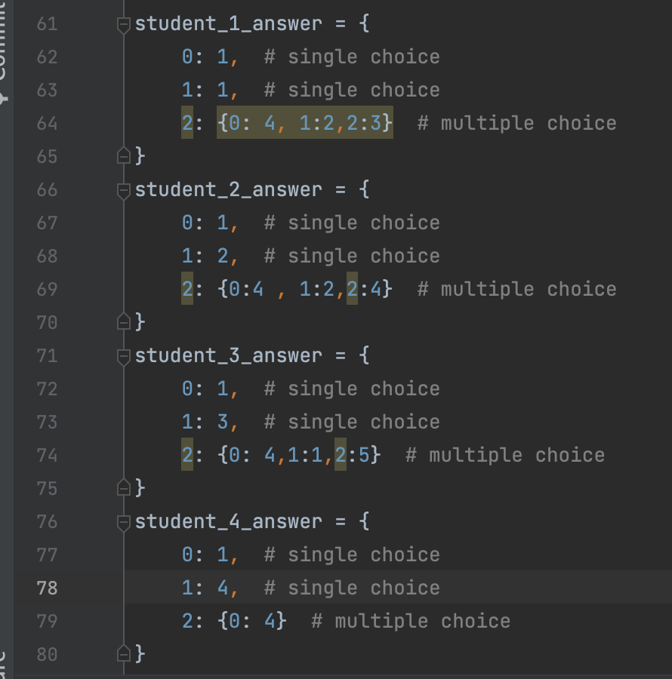
Coding Implement
Perfect match
Dissimilarity
Run result

Slide 11
How to calculate multiple choice questions score
Suppose we have 3 students in a team;
Multiple choice question qk has 5 options:[“Java”, “Python”,”C”,”C++”,”Haskell”], and each student need to choose their response by the order of their preference:
e.g. student A choice [“C”,”Java”,”C++”] → student like the “C” most, “Java” the second, “C++” third.
Question: how to come up a quantitative measurement for similarity of their response?
Map 0(similar response)– 1(dissimilar response)
Please consider the following responses:

Slide 12
Response 1
Student name | Option 1 | Option 2 | Option 3 | Option 5 | Option 4
A | 3( C++) | 1 (Java) | 2 (C)
B | 3 | 1 | 2
C | 3 | 1 | 2
D | 3 | 1 | 2
- Idea group -- > score should be 0 (max similarity)

Slide 13
Response 2
Student name | Option 1 | Option 2 | Option 3 | Option 5 | Option 4
A | 0(java)
B | 1(Python)
C | 2(C)
D | 3(C++)
- worst group -- > score should be 1 (min similarity)

Slide 14
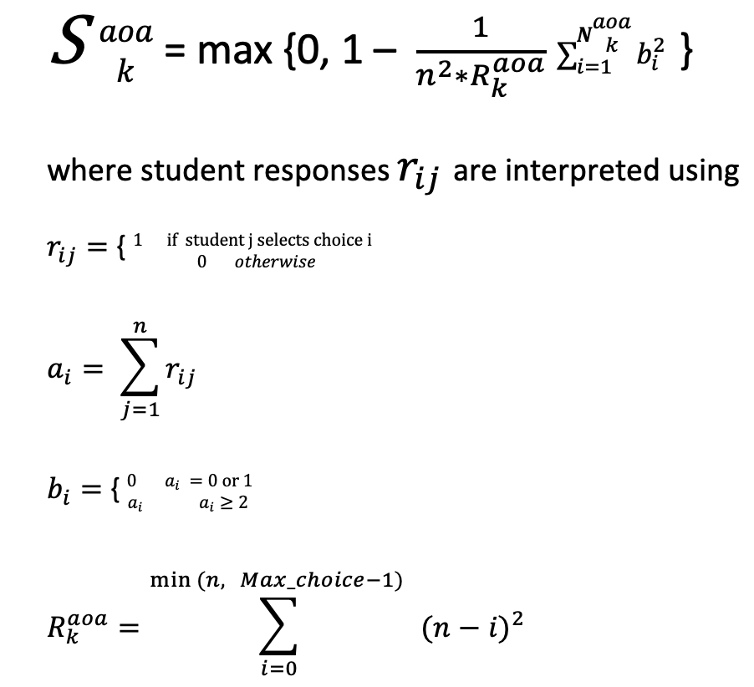
Objective score function – Choose any or all Question

Slide 15
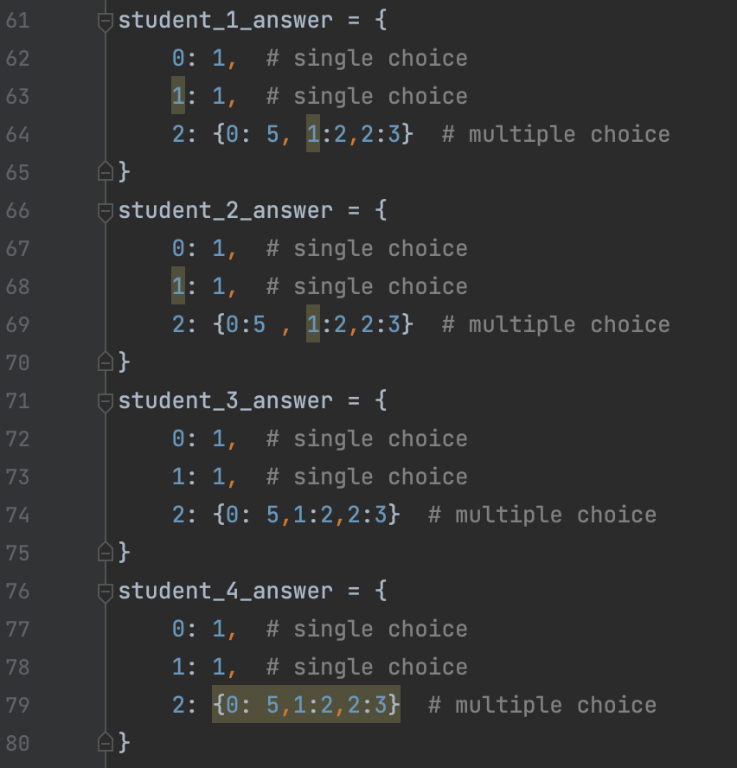
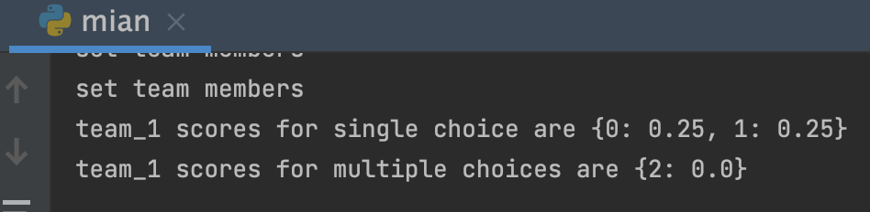
Coding Implement
example: max similarity, everyone in the team has the same preference

Slide 16
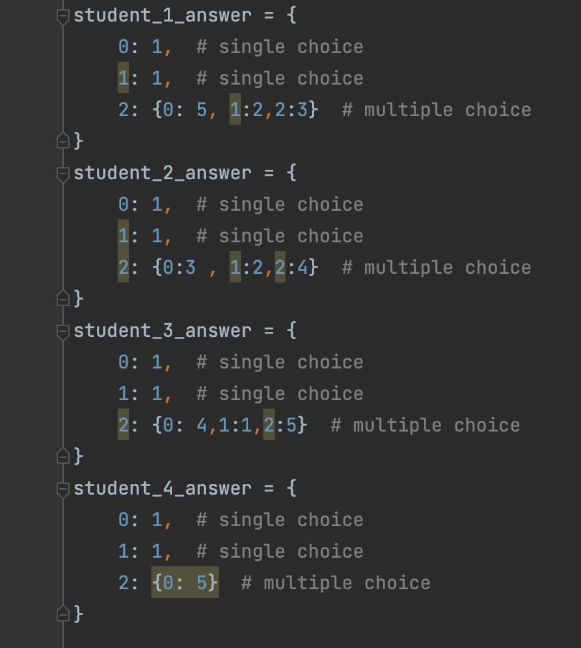
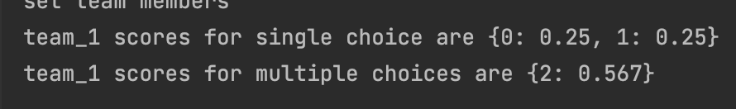
Coding Implement
In between example

Slide 17
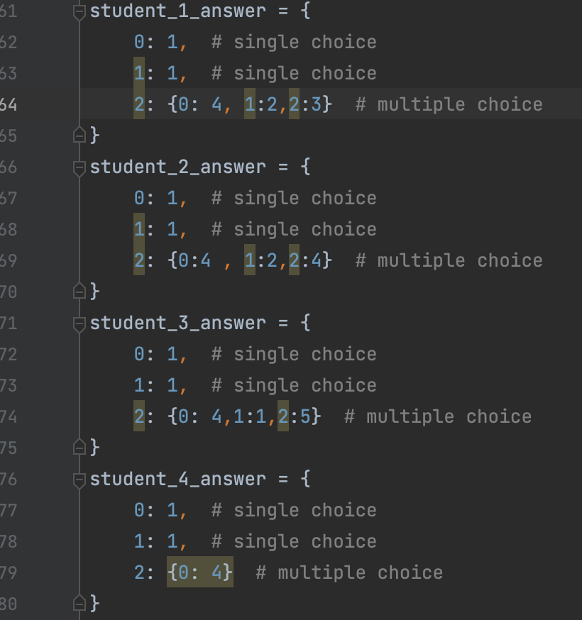
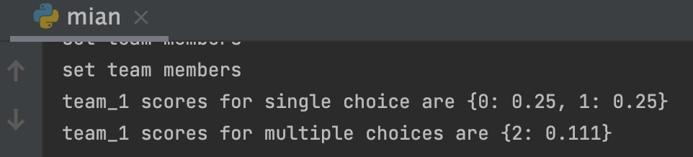
Coding Implement
better score, since all student’s first preference is 4

Slide 18
Next steps:
Swapping algorithm:
Hill climbing algorithm(find maximum team scores for each team)
Question:
how to increase the efficiency?
Algorithm side? Data structure side? (vector computing, numpy?)

Slide 19
Thanks for watching!

